Slide 1
Building and Managing SaaS Applications on SQL Database
SaaS patterns explored

Slide 2
Session objectives and takeaway
Equip you…
To choose among database models for multi-tenant SaaS apps
With SaaS patterns that can reduce development, management and resource costs
With a sample SaaS app + scripts to explore the patterns
Takeaway
PaaS features + SaaS patterns make SQL DB a highly scalable, cost-efficient data platform for multi-tenant SaaS

Slide 3
agenda
SaaS data management concerns
Database models for multi-tenant SaaS
Design and management patterns
Sample application details

Slide 4
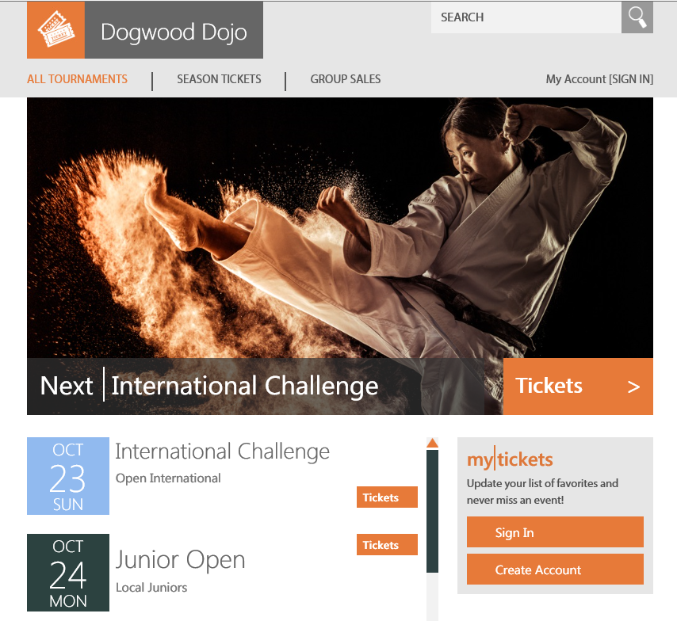
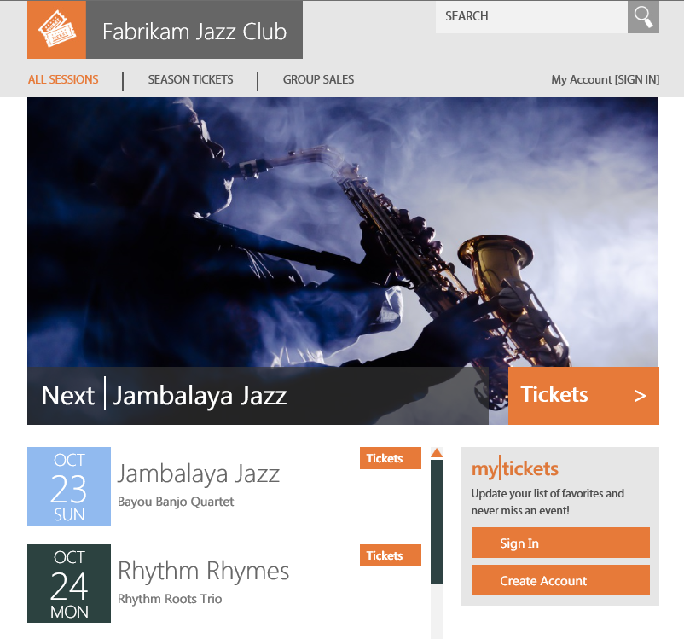
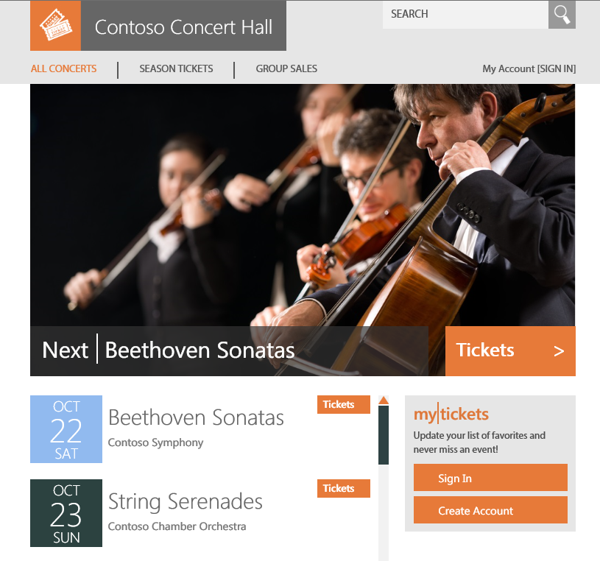
demo
Wingtip Tickets SaaS app

Slide 5
SaaS data management concerns
Cost per tenant
Scale -> tenants, data volume, workload
Tenant isolation -> security, privacy, performance, lifetime mgt...
Business continuity, disaster recovery
Customization > modularization, per-tenant schema variation

Slide 6
Alternative SaaS database tenancy patterns
Standalone App
Database per Tenant
Sharded Multi-tenant Database
Tenant C
Tenant B
Tenant A
App
App
App
Catalog
Catalog
Tenant DB
Tenant A
Tenant B
Tenant C
Tenant L
Tenant M
TenantsA,B,C,D
TenantsE,F,J,K

Slide 7
Comparing the models, what we see…
 | Standalone App | Database per tenant | Sharded Multi-tenant
Scale | High 1-1000s | Very high 1-100,000s | Unlimited 1-1,000,000s
Database cost–per tenant | High (sized for peaks) | Low (using pools) | Lowest (small tenants)
Tenant isolation | Very High | High | Low (high for singletons)
Performance monitoring/mgt. | Per-tenant | Aggregate + per-tenant | Aggregate, per-tenant for singletons only
Restore single tenant | Easy | Easy | Hard (easy for singletons)
Disaster recovery (all tenants) | Moderate Many components to recover | Moderate Patterns address complexity at scale | Easy (for multi-tenant dbs) Patterns address singleton complexity at scale
Development complexity | Low | Low | Medium (sharding)
Operational complexity | Medium-High Individually simple, complex at scale | Low-Medium Patterns address complexity at scale | Low-High Individual tenant management is complex
Per-tenant customization | Easy | Easy | Complex

Slide 8
demo
Wingtip Tickets sample
Standalone app
Database per tenant
Sharded multi-tenant

Slide 9
Microservices allows mixed storage/tenancy
Microservices
Modularized UI, orchestrates service calls
UI
UI
UI
REST API
Each service uses most appropriate language/stack
Service
Service
Service
Service
Catalog
Shard map per service or logical database
Tenant D
Tenant D
Tenants E,F,J,K
Services are mapped to storage and tenancy models to optimize cost and/or ease of development and management
Tenant C
Tenant C
Tenant B
Tenant B
Tenant A
Tenant A
TenantsA,B,C,D
Database per tenant
Sharded multi-tenant

Slide 10
Microservices allows mixed storage/tenancy
Microservices
Modularized UI, orchestrates service calls
UI
UI
UI
REST API
Each service can use most appropriate language/stack
Service
Service
Service
Service
Catalog
Shard map per service or logical database
Tenant D
Services are mapped to storage and tenancy models to optimize cost and/or ease of development and management
Tenant C
Tenant B
Tenant A
Database per tenant

Slide 11
Microservices allows mixed storage/tenancy
Microservices
Modularized UI, orchestrates service calls
UI
UI
UI
REST API
Each service uses most appropriate language/stack
Service
Service
Service
Service
Catalog
Shard map per service or logical database
Tenants E,F,J,K
Services are mapped to storage and tenancy models to optimize cost and/or ease of development and management
TenantsA,B,C,D
Sharded multi-tenant

Slide 12
Microservices allows mixed storage/tenancy
Microservices
Modularized UI, orchestrates service calls
UI
UI
UI
REST API
Each service uses most appropriate language/stack
Service
Service
Service
Service
Catalog
Shard map per service or logical database
Tenants E,F,J,K
Tenants E,F,J,K
Tenants E,F,J,K
Tenants E,F,J,K
Services are mapped to storage and tenancy models to optimize cost and/or ease of development and management
TenantsA,B,C,D
TenantsA,B,C,D
TenantsA,B,C,D
TenantsA,B,C,D
Sharded multi-tenant

Slide 13
Microservices allows mixed storage/tenancy
Microservices
Modularized UI, orchestrates service calls
UI
UI
UI
REST API
Each service uses most appropriate language/stack
Service
Service
Service
Service
Catalog
Shard map per service or logical database
Tenant D
Tenant C
Tenants E,F,J,K
Services are mapped to storage and tenancy models to optimize cost and/or ease of development and management
Tenant B
Tenant A
TenantsA,B,C,D
NoSQL
SQL

Slide 14
Patterns compose into E2E SaaS scenario
Tenant self service
Geo-replication, failover groups
Reactive
Geo-replicate dbs for fastest recovery
Geo-restore, aliases
Restore from geo-redundant backup
Tenant self service
Azure Automation
Pro-active
Azure Active Directory
Scheduled
Active/active cross-replication
Managed recovery of tenants at scale
PITR
Recover tenant data after tenant error
Authentication,
access control
Reactive
Handle intense isolated tenant workload
Pro-active
Elastic Jobs
SQL DW SQL DB + ColumnStore
Handle fluctuating aggregate workload
Geo-distributed tenant dbs
Azure Search
BCDR
Extract and analyze tenant data
Search
Scheduled
Multi-tenant SaaS app
PowerBI
Azure Automation + ARM templates
Cross-tenant Analytics
Manage performance
Query across tenant databases
Monitoring and alerting
ARM template, bacpac, db-copy
Elastic Query
Elastic Pools
Scale databases
Manage schema change
Elastic Jobs
Portal + OMS
Provision database and schema
Catalog tenants and databases
Monitor app and data layer
Manage schema versioning via catalog
Auto-provision databases
Elastic Database Client Library, Shard Management schema
Load-balance
Pre-provision databases to reduce tenant onboarding latency
Browse tenants
Connect app to tenant database
Manage extended tenant meta data
Elastic Pools

Slide 15
exploring the patterns
Notes:
All the demos in this section can be done with the sample app…

Slide 16
Provisioning tenants and connecting at runtime
Apps
Catalog
Tenant Catalog
Cust 1
Cust 2
Cust 3
Cust N
Tenant Databases

Slide 17
Provisioning tenants and connecting at runtime
Tenant Onboarding
Application Connection
A. Venue signs up as new tenant
1. User connects to the app
2. App uses key to get connection from catalog
B. App provisions new tenant db
Apps
3. …then connects to correct tenant database
C. …registers tenant key, db location in catalog
EDCL
4. On subsequent requests, uses database location cached in EDCL
Tenant bacpac
Base TenantDB
ARM / SQL Database
Catalog
Tenant Catalog
Cust 1
Cust 2
Cust 3
Cust 4
Cust N
EDCL
Elastic Database Client Library
.NET, Java
Tenant Databases

Slide 18
demo
Management scripts
Provisioning a single tenant

Slide 19
Pools are cost-effective for unpredictable workloads
Hourly
share resources
Daily
Weekly
9:00
9:15
9:30
9:45
10:00
0:00
12:00
2017
2015
2016
23:59
Mon
Tue
Wed
Thu
Fri
Sat
Sun
Yearly
Elastic Pool
Individually unpredictable
Collectively stable and predictable
Expensive, must provision each db for peaks
Cost effective, scale pool up/down based on trends

Slide 20
Case study: Large accounting ISV
Targets small/medium businesses
Migrated an established desktop app to the cloud
Client/server app migrated easily to a database-per-tenant model
Initially used standalone databases, now using databases in elastic pools
150,000 tenant databases in 300+ elastic pools
Growing at 3-5K databases per month

Slide 21
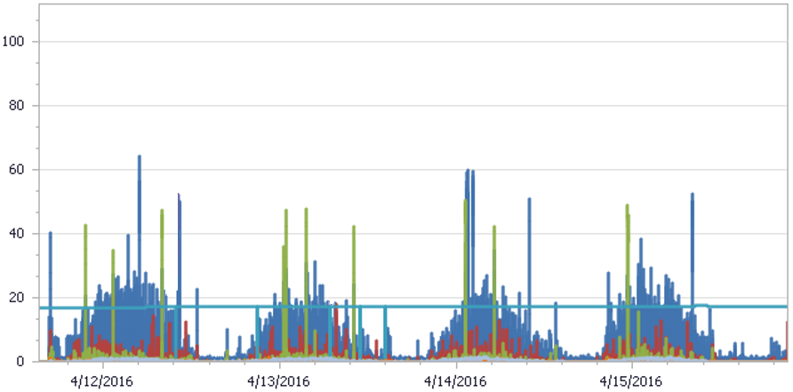
Elastic pool usage example
385 dbs in 200 DTU pool, per-database max at 100 DTUs
Notes:
Real telemetry from an accounting customer’s set of pools (when this data was recorded they had over 300 pools, and each pool had nearly 400 databases sharing 200 DTUs).
As you can see, their aggregate tenant workload is easily supported by 200 DTU pool.
[The pool at 200 DTUs is twice the per-database max of 100 DTUs so would allow 2 databases to be active]

Slide 22
Managing unpredictable tenant workloads
1. Provisioning service creates pool
2. …pre-provisions databases
3. As tenants register they are assigned databases
Apps
4. Service pre-provisions next pool and databases
5. Pool is scaled to handle more load/databases
ARM / SQL Database
Catalog
6. Databases are moved to load-balance pools
7. Databases can be moved out if they become very active
pool1
pool2
pool3
Cust 4
Cust 17
Cust 1
Cust 2
Cust 3
Cust 10
Cust 11
Cust 12
Cust 13

Slide 23
demo
Performance experience with unpredictable SaaS workloads - elastic pool vs multi-tenant db

Slide 24




Schema management at scale
To join preview of elastic jobs contact saasfeedback@microsoft.com
Manage 1000s of databases as one
Azure Portal
Apps
T-SQL
CREATE TABLE…
CREATE INDEX…
INSERT INTO…
SELECT * FROM…
T-SQL Job
SELECT * FROM…
Job Account
Jobs, target groups, schedules, credentials
Catalog
Tenant Catalog
Cust 1
Cust 2
Cust 3
Cust 4
Cust N
Elastic Jobs
T-SQL
T-SQL
T-SQL
T-SQL
T-SQL
Tenant Databases

Slide 25


Distributed query across tenant databases
Query all tenants as if they are in a single database
PowerBI
Apps
Query from any client
Database locations are retrieved from catalog
Elastic Query
Catalog
Adhoc Analytics
External tables project data from tenant dbs
Tenant Catalog
Cust 1
Cust 2
Cust 3
Cust 4
Cust N
Distributed query plan
Tenant Databases

Slide 26
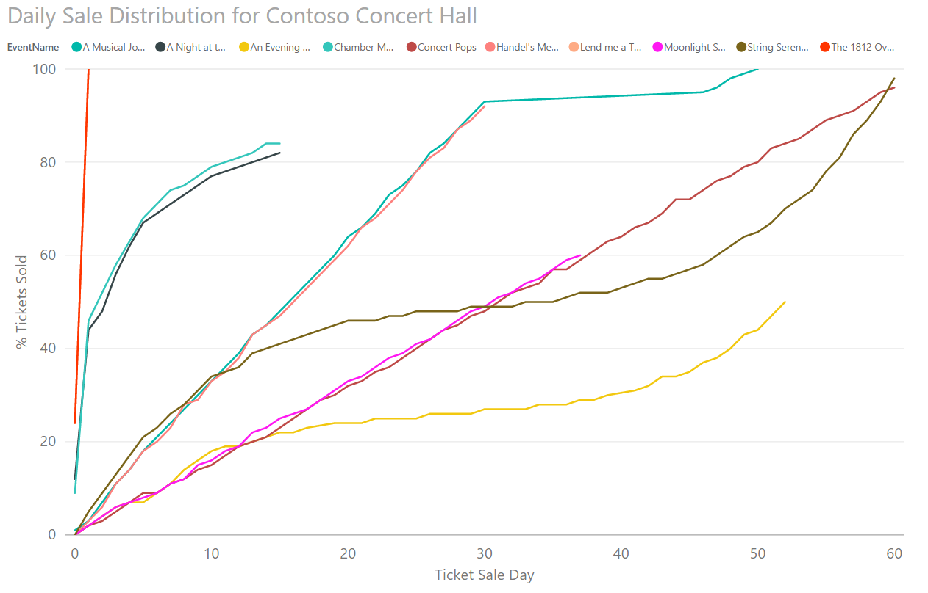
Extract tenant data into an analytics DB or DW
Unlock operational and application insights
PowerBI
Azure Portal
Apps
Query from any client
T-SQL
CREATE TABLE…
CREATE INDEX…
INSERT INTO…
SELECT * FROM…
T-SQL Job
SELECT * FROM…
Job Account
Catalog
Adhoc Analytics
Tenant Analytics
Tenant Catalog
SQL DB with ColumnStore or SQL DW
Cust 1
Cust 2
Cust 3
Cust 4
Cust N
Elastic Jobs
T-SQL
T-SQL
T-SQL
T-SQL
T-SQL
Tenant Databases

Slide 27
Wingtip Tickets sample SaaS apps
Multiple versions explore different tenancy models
Database-per-tenant
Sharded multi-tenant
Standalone app
Microservices (planned)
Each app deploys to Azure in under 5 mins
All code, scripts on GitHub
https://github.com/Microsoft/WingtipTicketsSaaS-DbPerTenant
https://github.com/Microsoft/WingtipTicketsSaaS-MultiTenantDb
https://github.com/Microsoft/WingtipTicketsSaaS-StandaloneApp
Management tutorials online https://aka.ms/sqldbsaastutorial

Slide 28
scenarios and patterns explored in the app and tutorials
Tenant provisioning and registration in catalog
Connection to tenant database via catalog
Monitoring and alerting
Performance management (incl. scaling/balancing pools)
Tenant database schema management
Distributed query across tenants
Cross-tenant analytics using PowerBI
Restore single tenant to recover from tenant error
DR using geo-restore (in progress)
DR using geo-replication (in progress)
Wingtip Tickets sample SaaS app

Slide 29
Wrap up and call to action
You should now be equipped…
To choose the SaaS database model appropriate to your scenario
To explore SaaS-specific patterns that can reduce development, management and resource costs, and time-to-market
Takeaway
PaaS features + SaaS patterns make SQL DB a highly scalable, cost-efficient data platform for multi-tenant SaaS
Install the samples, try the tutorials, send us feedback
saasfeedback@microsoft.com
Notes:
Try out the samples and give us your feedback
What was helpful, what wasn’t? What should we add?
What are your SaaS scenarios and patterns?
How do you do database development at scale?
What’s blocking adoption, or creating friction?
Come by and talk to us at the SQL stand
Set up a 1:1 here, or remotely, after the Ignite
Send mail to saasfeedback@microsoft.com

Slide 30
SaaS ISV survey https://aka.ms/saassurvey

Slide 31
Resources
Blog post https://azure.microsoft.com/en-us/blog/saas-patterns-accelerate-saas-application-development-on-sql-database/
GitHub repo https://github.com/microsoft/wingtipsaas
Tutorials https://aka.ms/sqldbsaastutorial
Getting started guide - installing and exploring the app https://docs.microsoft.com/en-us/azure/sql-database/sql-database-saas-tutorial

Slide 32
Learn more from Bill Gibson
Bill.Gibson@microsoft.com

